Slide 1
Formal Verification of RL-based Approaches

Slide 2
Why Verification / Motivation
Overview Formal Verification (Model Checking, SMT, LTL, …)
SMT Example
Use Case
Challenges
Different Types of Verification + Example
Neural Networks Verification?
(Safe RL)
Paper1, Paper2, …
Open Questions
Problems
Own Thoughts / Opinion

Slide 3
Topics
Our Introduction
Why Formal Verification, Problems in RL, Motivation, Our Research Questions
Introduction to Formal Verification
Model Checking
What can be verified in RL?
Offline Verification
Neural Networks, Reluplex, …
Online/Runtime Verification
ModelPlex Paper, …
Open Questions and Problems
Opinion, …

Slide 4
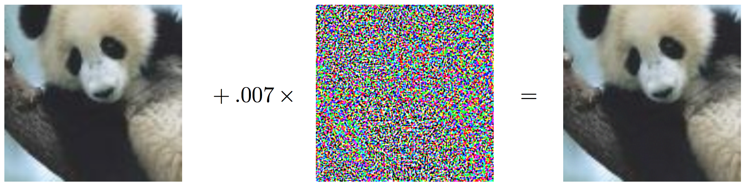
We cannot use “confidence” as safety measure
“panda” 57.7% confidence
“gibbon” 99.3% confidence
Notes:
https://arxiv.org/pdf/1412.6572.pdf (2015)

Slide 5
Adversarial Examples in the Real World

Slide 6
And we need a method to detect abnormal situations

Slide 7
https://www.youtube.com/watch?v=_CdJ4oae8f4
“Self-Driving Uber running red light”

Slide 8
How can we ensure that our machine works well in these situations?

Slide 9
Why Formal Verification?

Slide 10
Testing does not suffice
Testing does not suffice
“Program testing can be a very effective way to show the presence of bugs, but is hopelessly inadequate for showing their absence.“
Who said that?

Slide 12
But Formal Verification in general is hard
Undecidable to be exact…
We can only verify a “subset” of problems

Slide 13
Why would we want to combine Formal Verification and Reinforcement Learning?

Slide 14
Formal Verification can only provide a safe policy
RL can provide an optimal policy which might not be safe
Combine these to get an optimal & provable safe policy?

Slide 15
//Why Formal Verification?
Safety
Ensure that learning does not cause harm
esting does not suffice → Safety
Bugs can be prevented
Ensure that a (learned) policy ”works”
Already standard in many areas! (aviation)
Faster learning:
During learning, unsafe policies are explored
poor initial performance → faster learning
Exploit domain knowledge
“Sanity Checks”, Increase confident in method
Ensure reachability
Ensure we work with a valid model!
Cost Reduction
Find out about bugs early and be in a better position to fix them
Organizational matters
Certification processes

Slide 16
//Research Question
How can we ensure that the model will always act in a safe way? (not damaging something)
How can we deal with uncertain situations?
Does Formal Verification make autonomous driving 100% safe?
Other Questions we could name (but not address)
“Small perturbation of input will not affect the learning“

Slide 17
//Introduction to Formal Verification
Rough overview over methods
PRISM, System monitors, ...
Maybe name some approaches for autonomous driving
I would treat formal verification as a “black box“ in our setting.
Differential Dynamic Logic

Slide 18
Introduction to Formal Verification

Slide 19
Introduction to Formal Verification

Slide 20
Model Checking
“Model checking is an automatic technique for verifying correctness properties of safety-critical reactive systems“ [Clarke, Schlingloff: Model Checking, in Handbook of Automated Reasoning, Band II, S. 1637–1790, 2001]
System Model (e.g. via a finite state machine)
Specification via Formulas (e.g. via Temporal Logic (CTL))
Verification Method
Model Checking Tool → Yes (model satisfies specifications) / No (with a Counter Example)
Example: symbolic model verifier (SMV)
CTL: Extension of boolean logic

Slide 21
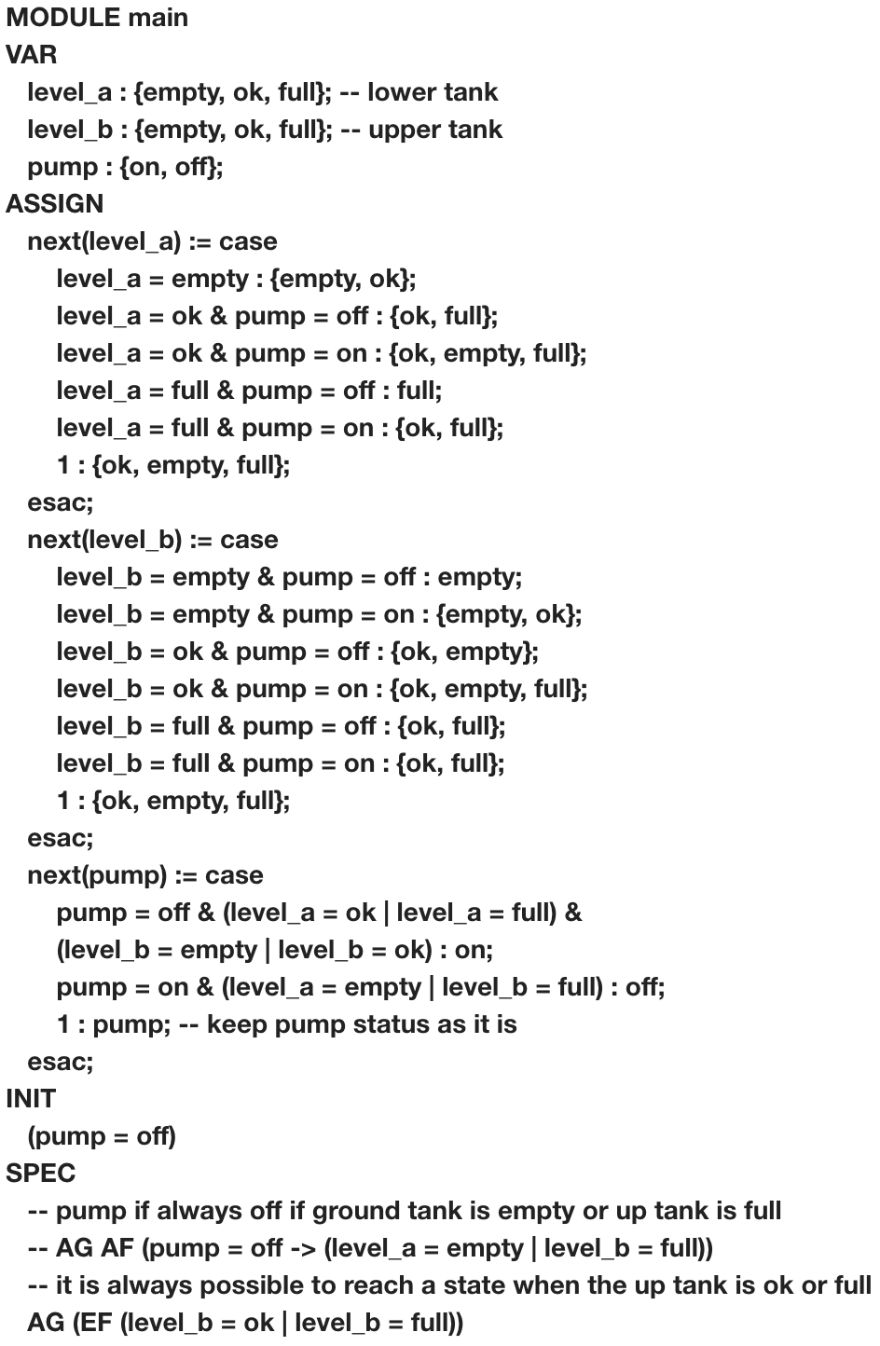
Model Checking Example
https://www.embedded.com/design/prototyping-and-development/4024929/An-introduction-to-model-checking
// Show counter example
// Example: (pump = off) -> AF (pump = on)

Slide 22
SMT Simple Verification Example
I am not sure about this one.. We should rather focus on model checking since it seems to be more understandable

Slide 23
What can be verified?
Offline: validate after learning
State to Action: Verify that a certain action will not happen in a given state
Action sequences (via PRISM)
Algorithm properties (e.g. convergence to a fix point)
Assumptions on Training Data (variable ranges, …)
Online: validate during learning
State to Action
Action sequences
Monitoring

Slide 24
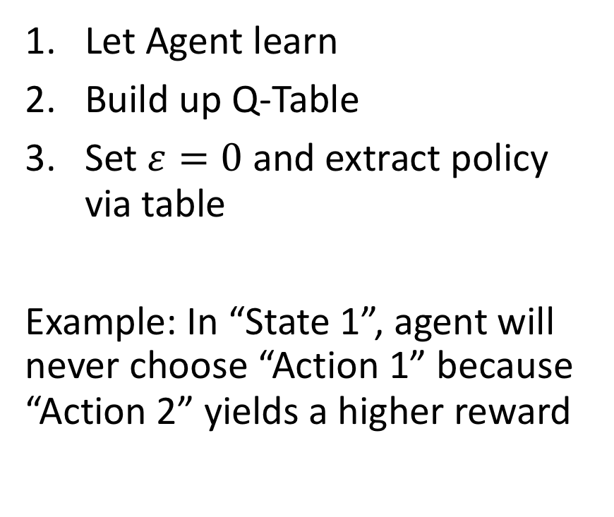
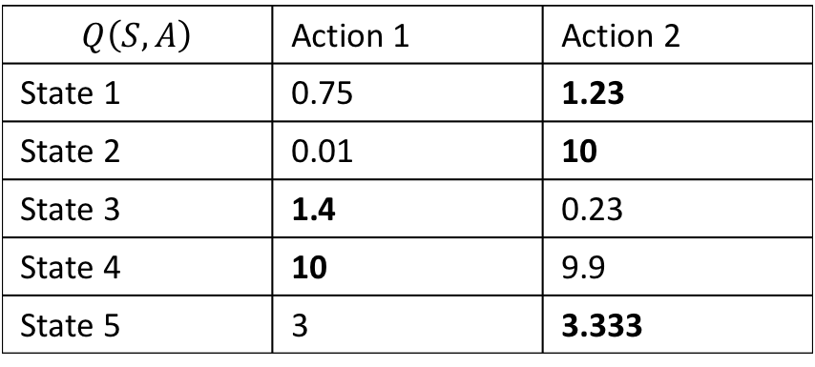
State to Action Verification in Q-Learning
$$Q\left(S, A\right)$$ | Action 1 | Action 2
State 1 | 0.75 | 1.23
State 2 | 0.01 | 10
State 3 | 1.4 | 0.23
State 4 | 10 | 9.9
State 5 | 3 | 3.333
Let Agent learn
Build up Q-Table
Set $ε=0$ and extract policy via table
Example: In “State 1”, agent will never choose “Action 1” because “Action 2” yields a higher reward

Slide 25
What about function approximation?
Usually: continuous states & function approximation via neural network
“How ‘much’ can I modify my state (e.g. a picture of a camera)” such that we still produce the same action
Solution: Reluplex: An Efficient SMT Solver for Verifying Deep Neural Networks

Slide 26
Verification of Neural Networks
Adversarial examples
For example: https://arxiv.org/pdf/1707.08945.pdf
SMT, …

Slide 27
//describe RELUPLEX …

Slide 28
Action Sequences
PRISM

Slide 29
Model Checking: PRISM
One of the models that PRISM can check are “MDPs”
PRISM language is a variant of PCTL, LTL, and many more
Probabilistic reachability

Slide 30
Algorithm properties
Theorem on Q-Learning that converges

Slide 31
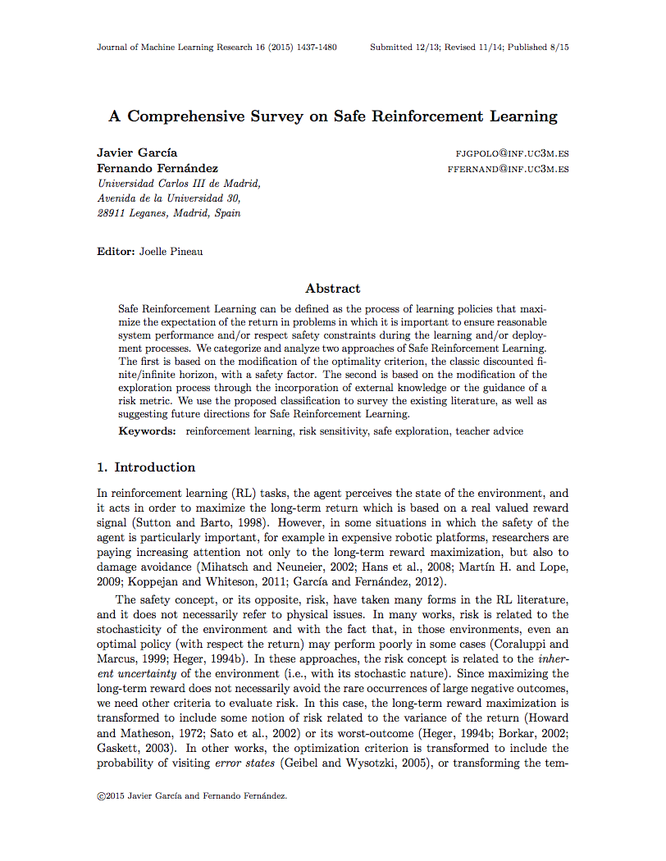
A Comprehensive Survey on Safe Reinforcement Learning (≤ 2015)
…

Slide 32
Lyapunov Functions

Slide 33
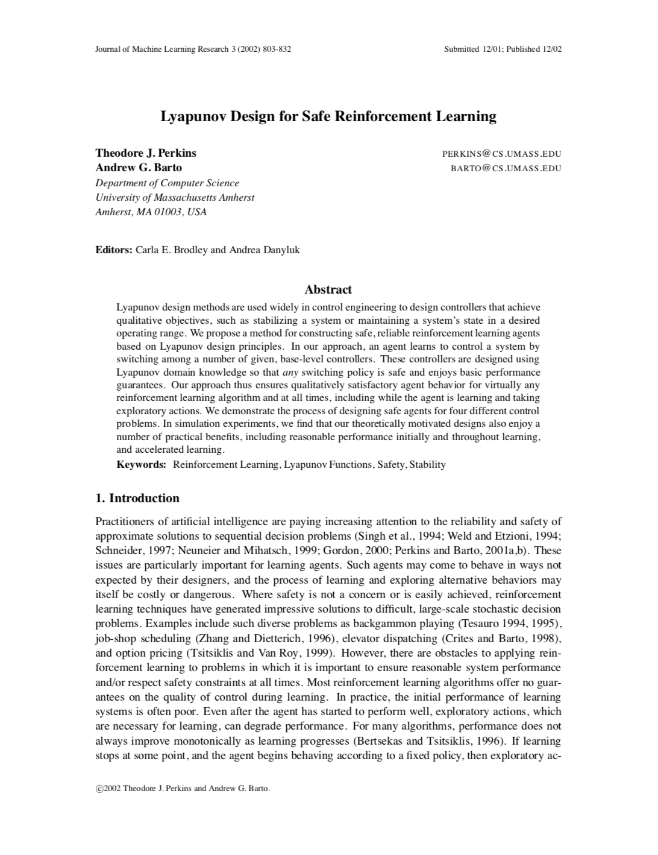
Lyapunov Design for Safe Reinforcement Learning (2002)
Optimal Control Problems
Works with any RL Algorithm
Idea: For a given problem, define actions that ensure any action will keep agent in safe state and moves it eventually there
Use RL to find a good combination of these actions
Problem: You need to come up with these actions by yourself

Slide 34
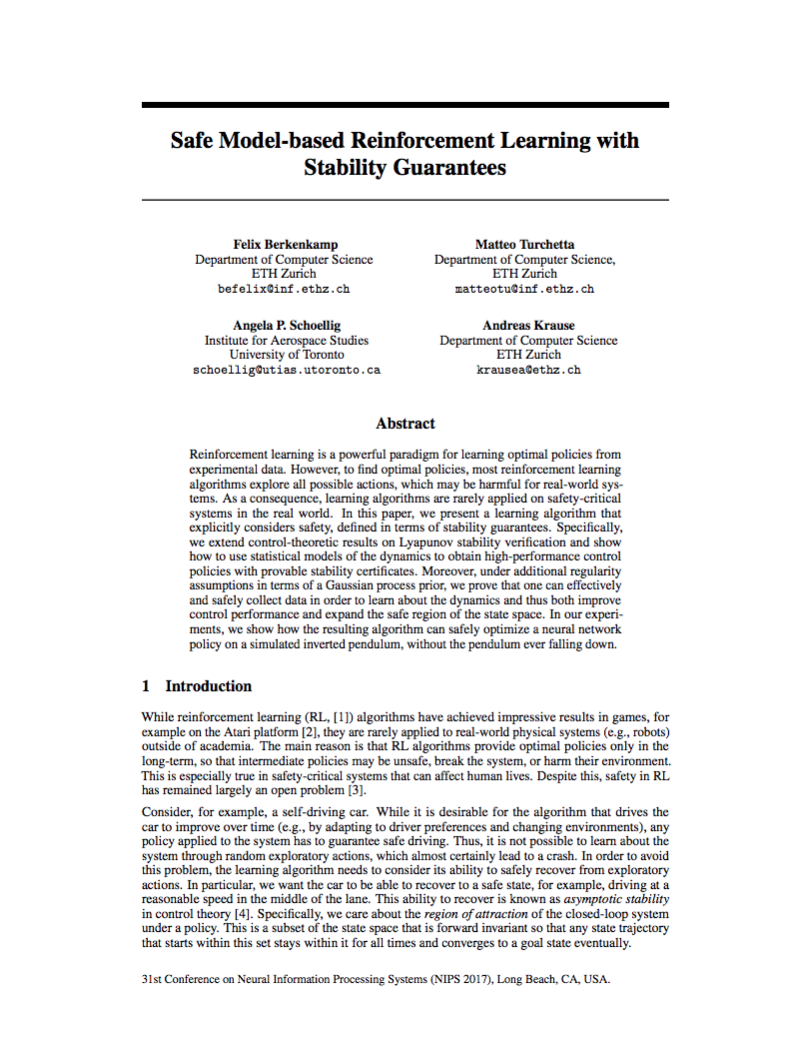
Safe Model-based Reinforcement Learning with Stability Guarantees (2017)
Main Idea: Be able to recover from every situation: “Asymptotic Stability”
Start with an initial, safe policy
Compute “region of attraction” via Lyapunov functions
Exploration will increase safe region and region of attraction

Slide 35
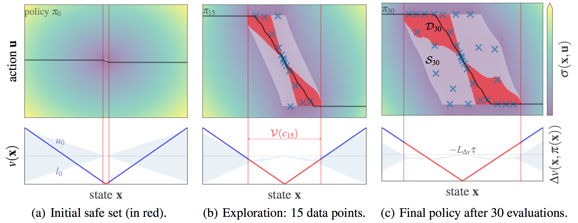
Region of Attraction

Slide 36
Problems
Safety in terms of probability. Probabilities can fail
Example: 99.999% it works, there are 1 000 000 drivers → it won’t stay safe for 10 drivers

Slide 37
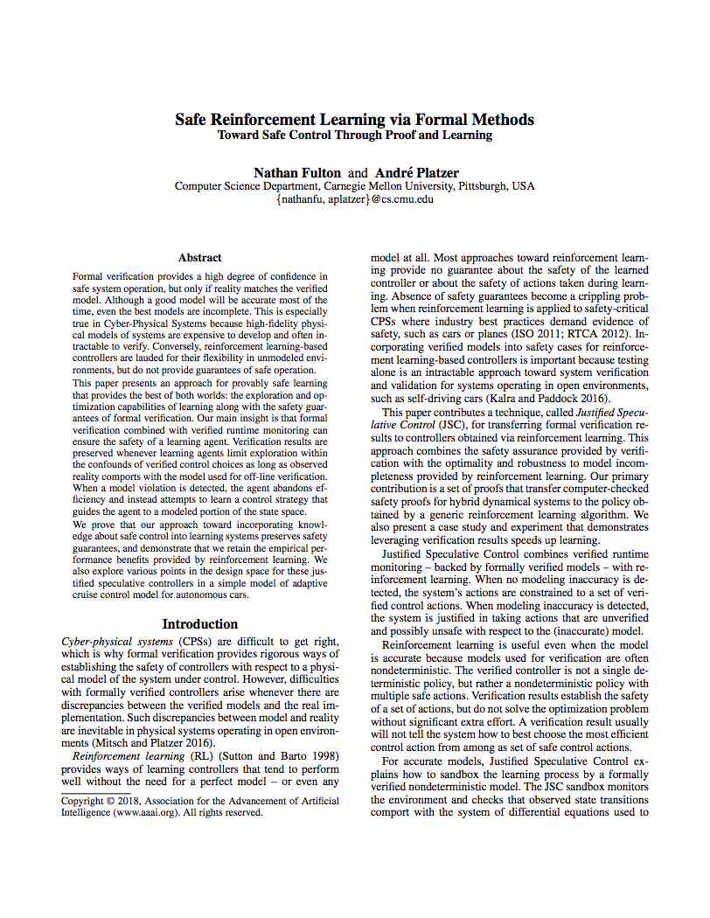
Safe Reinforcement Learning via Formal Methods (2018)
Model accurate: Choose safe action that maximizes reward
Model inaccurate: Choose any action that maximizes reward
Model Monitor: Is the model accurate?
Controller Monitor: Is an action safe?
Any safe action keeps the system safe

Slide 38
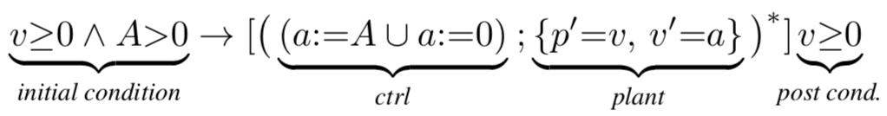
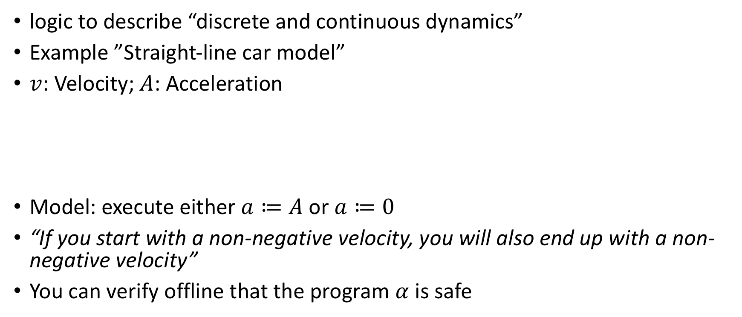
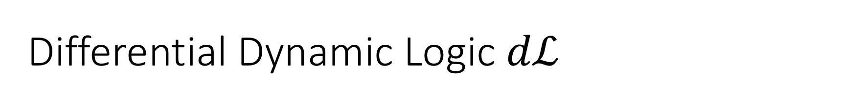
Differential Dynamic Logic $dℒ$
logic to describe “discrete and continuous dynamics”
Example ”Straight-line car model”
$v$: Velocity; $A$: Acceleration
Model: execute either $a≔A$ or $a≔0$
“If you start with a non-negative velocity, you will also end up with a non-negative velocity”
You can verify offline that the program $α$ is safe

Slide 39
Hybrid program
precondition
postcondition

Slide 40
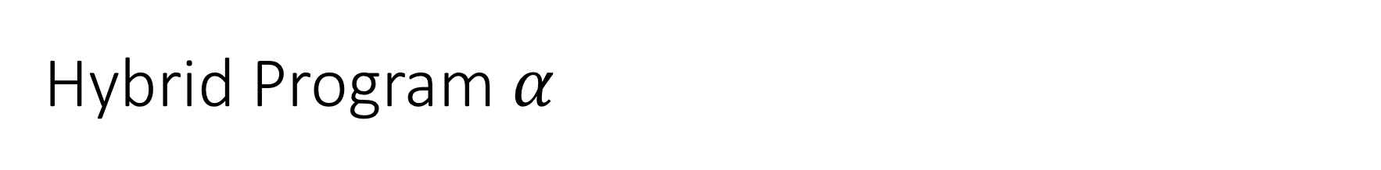
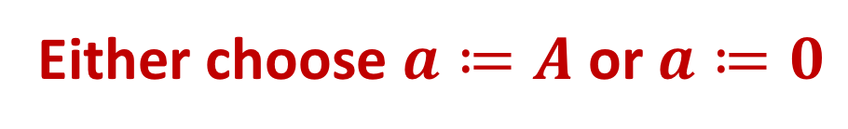
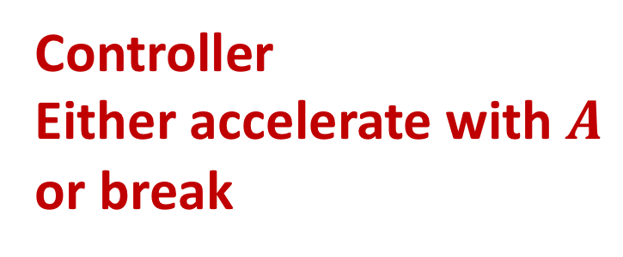
Hybrid Program $α$
Repeat arbitrary times
Controller
Either accelerate with $A$ or break
Model differential equations describe behavior
Either choose $a≔A$ or $a≔0$

Slide 41
If our car moves forward with non-negative velocity
after choosing actions, it still has a non-negative velocity

Slide 42
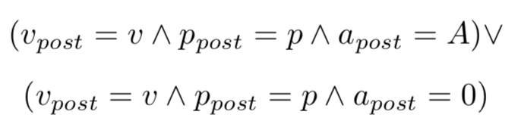
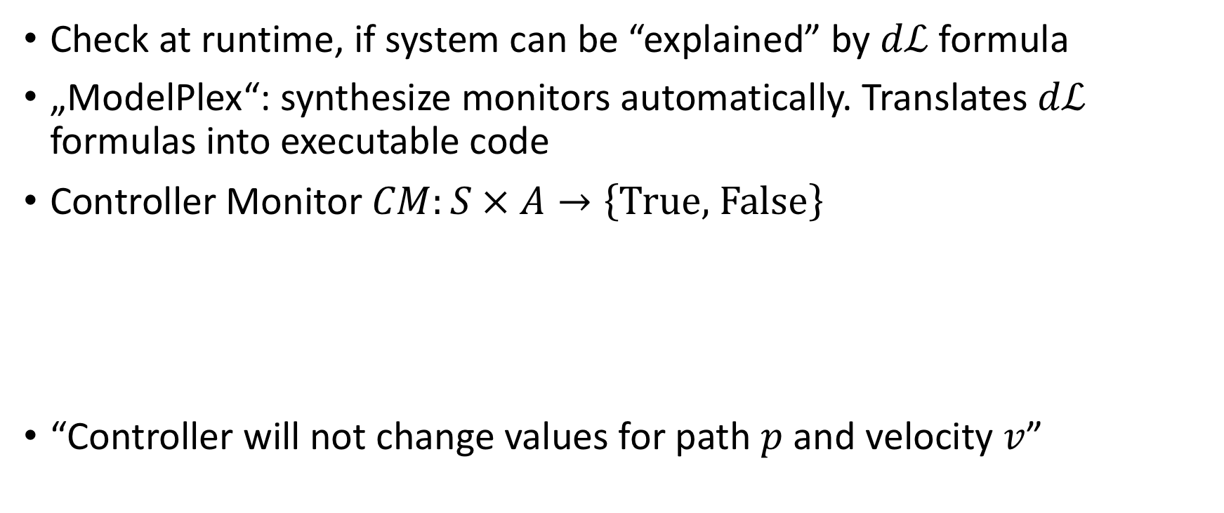
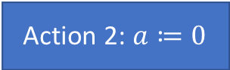
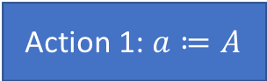
Controller Montor
Check at runtime, if system can be “explained” by $dℒ$ formula
„ModelPlex“: synthesize monitors automatically. Translates $dℒ$ formulas into executable code
Controller Monitor $CM:S × A→\left\{\text{True}\text{, }\text{False}\right\}$
“Controller will not change values for path $p$ and velocity $v$”
Action 1: $a≔A$
Action 2: $a≔0$

Slide 43
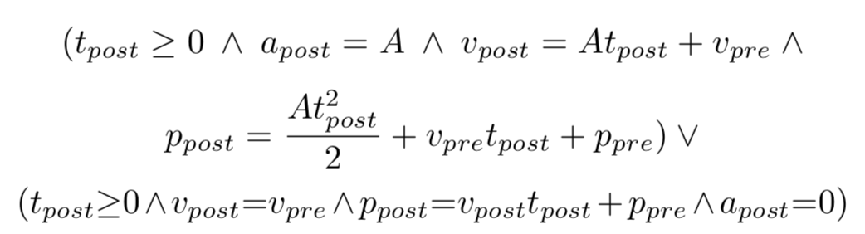
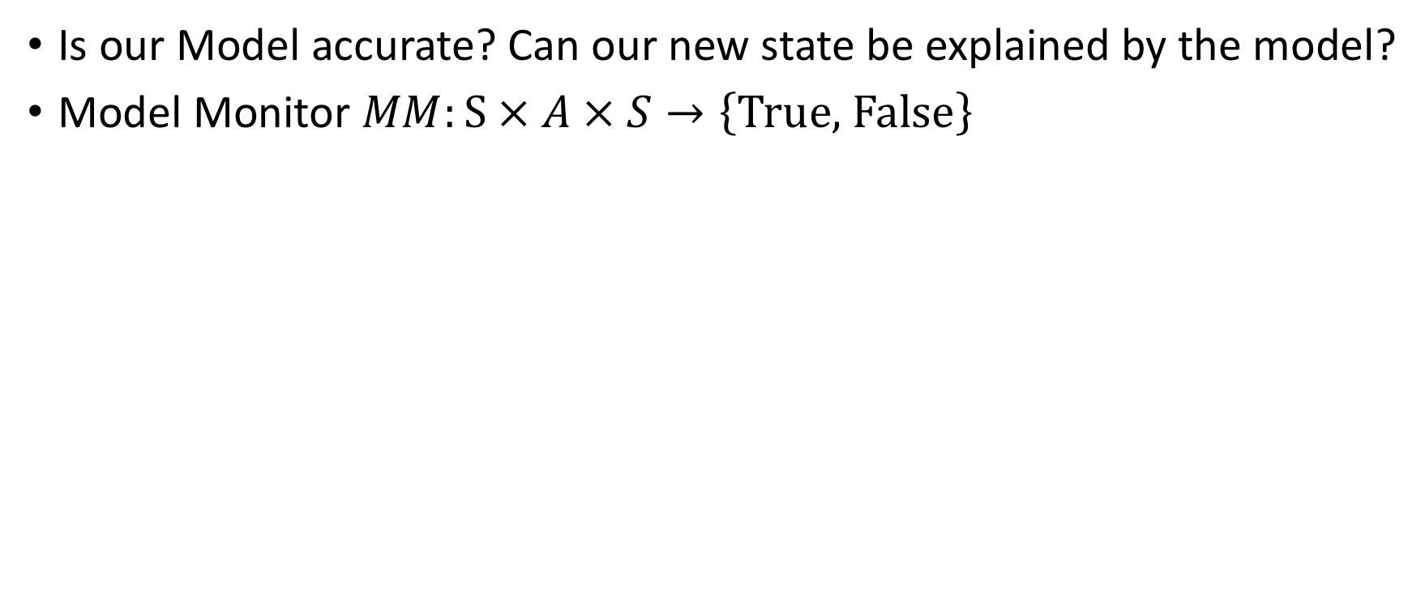

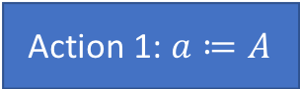
Model Monitor
Is our Model accurate? Can our new state be explained by the model?
Model Monitor $MM:S × A × S→\left\{\text{True}\text{, }\text{False}\right\}$
Action 1: $a≔A$
Action 2: $a≔0$

Slide 44
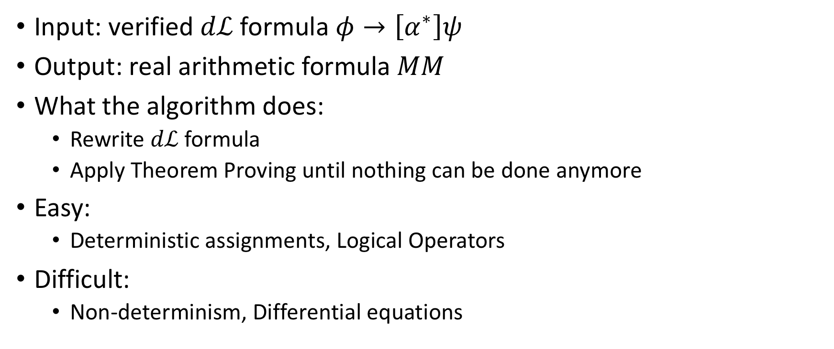
ModelPlex
Input: verified $dℒ$ formula $φ→\left[α^{∗}\right]ψ$
Output: real arithmetic formula $MM$
What the algorithm does:
Rewrite $dℒ$ formula
Apply Theorem Proving until nothing can be done anymore
Easy:
Deterministic assignments, Logical Operators
Difficult:
Non-determinism, Differential equations

Slide 45
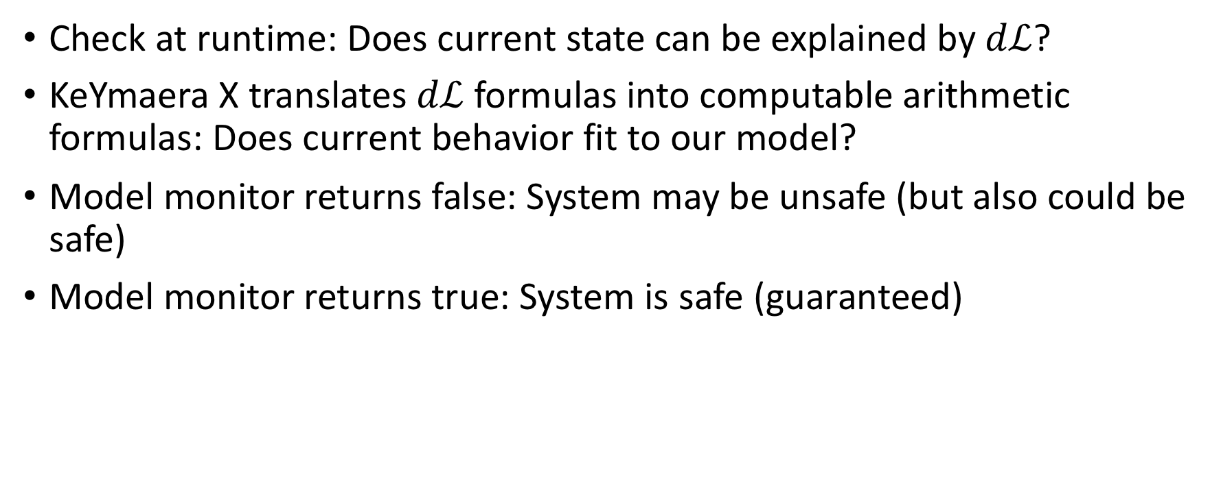
ModelPlex
Check at runtime: Does current state can be explained by $dℒ$?
KeYmaera X translates $dℒ$ formulas into computable arithmetic formulas: Does current behavior fit to our model?
Model monitor returns false: System may be unsafe (but also could be safe)
Model monitor returns true: System is safe (guaranteed)

Slide 46
Model might not reflect reality due to
Sensor errors
Mechanics malfunctions
Wrong (too simple) assumptions which do not hold in real life

Slide 47
Algorithm
JSCGeneric(init, (S,A,R,E), choose, update, done, CM, MM) {
prev := curr := init;
a0 := NOP;
while (!done(curr)) {
if (MM(prev, a0, curr))
u := choose({a ∈ A | CM(a,curr)});
else
u := choose(A);
prev := curr;
curr := E(u, prev);
update(prev, u, curr);
}
}

Slide 48
Example Adaptive Cruise Control

Slide 49
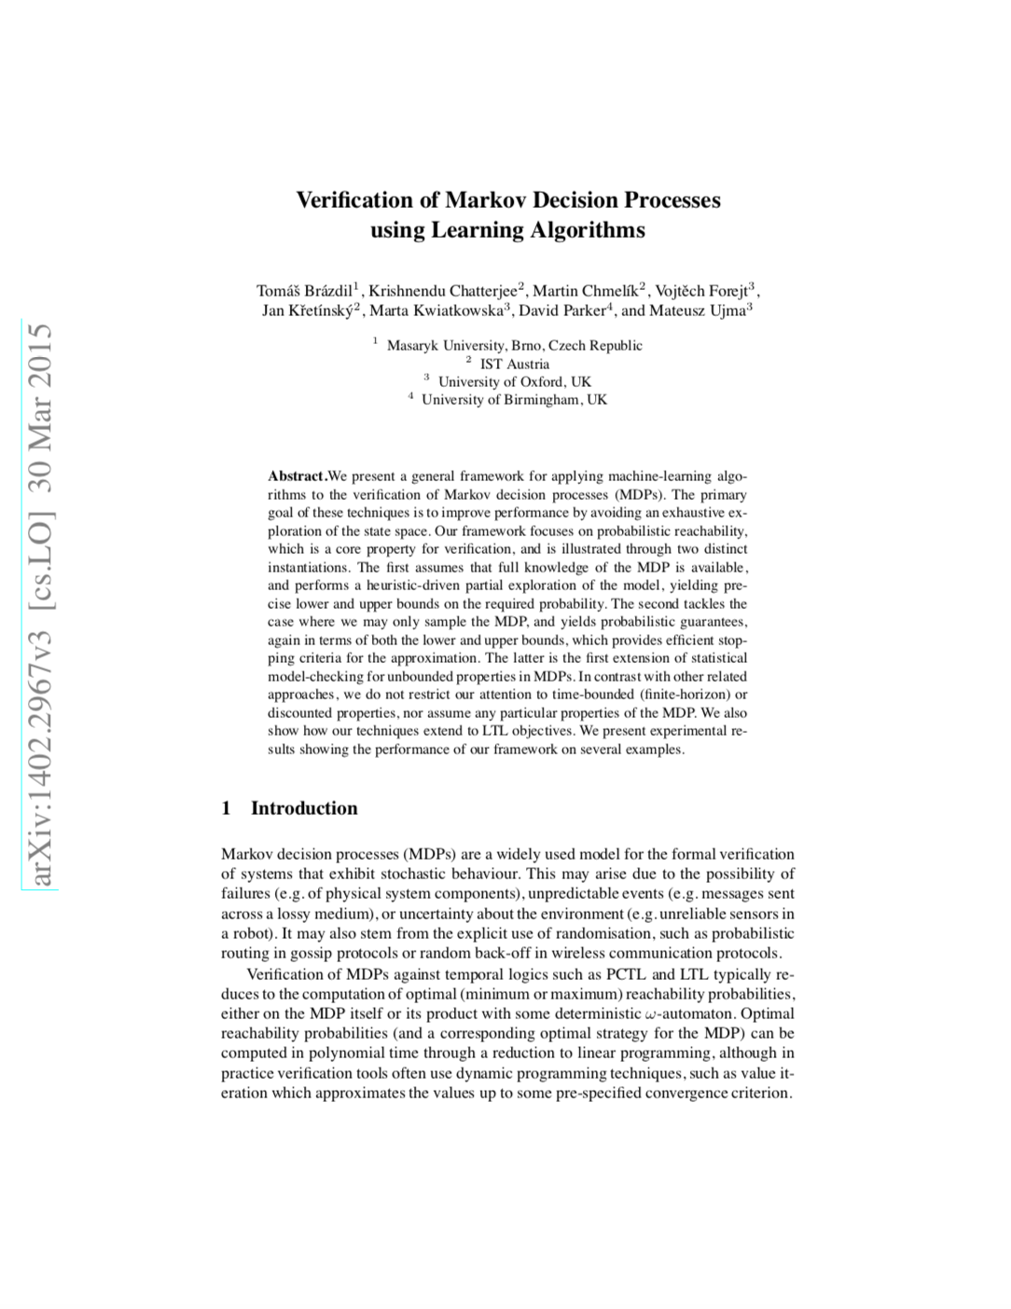
Verification of Markov Decision Processes using Learning Algorithms (2015)
?

Slide 50
DAGGER

Slide 51
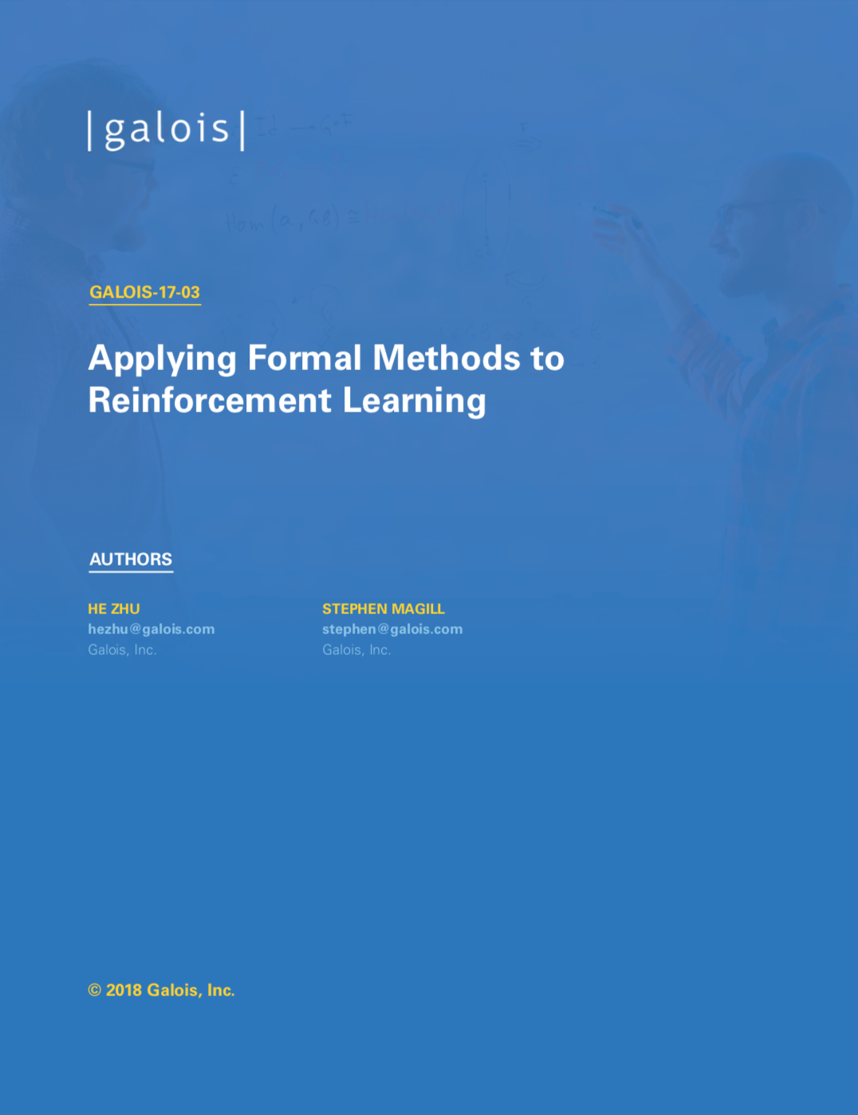
Applying Formal Methods to Reinforcement Learning (2018)
Learn from demonstrations
Problem 1: Agent may encounter unseen situations
Solution: Dataset-Aggregation
Problem 2: Generate “expert” trajectories automatically
Solution: Reward function synthesis using formal methods.

Slide 52
//Proposed Method
Name some ideas?
Advantages and disadvantages
Boost safe method with formal verification
Show that a certain approach does not work
...

Slide 53
//Formal Verification – The solution?
Conclusion, Research Direction, ...
Short discussion on the research questions
Why formal verification does not make driving 100% save

Slide 54
Open Questions and Problems
…

Slide 55
General Problems
Domain knowledge might be wrong
Model might not reflect reality
Constraints are hard to come up with
Probabilities
numeric errors → Verification of the implementation
Assumptions might be violated (or not considered!)
Continuity of dynamics, i.i.d., …

